Slide 1
Designing for Visibility
Chapter 19
Applying UML and Patterns
Craig Larman

Slide 2
Objectives
Identify four kinds of visibility
Design to establish visibility
Illustrate kinds of visibility in the UML notation

Slide 3
Introduction
Q. What is visibility?
A. Visibility is the ability of one object to see or have reference to another.

Slide 4
Visibility Between Objects
Q. When is visibility necessary?
A. To send a message from one object to another, the receiver object must be visible to the sender, so the sender has to have a pointer or reference to the receiver.

Slide 5
Visibility Between Objects
Example:
Q. If A sends messages to B, which must be visible to which?
A. B is visible to A means A can send a message to B.

Slide 6
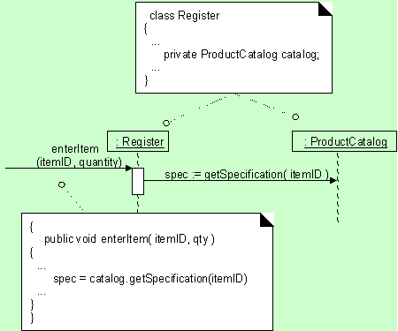
Visibility Between Objects

Slide 7
Visibility
Visibility is related to the scope:
  Is one resource (such as an instance) within the scope of another?
The motivation to consider visibility:
  For an object A to send a message to an object B, B must be visible to A.

Slide 8
Four Kinds of Visibility
How visibility can be achieved from object A to object B:
Attribute visibility - B is an attribute of A
Parameter visibility - B is a parameter of a method of A
Local visibility - B is a local object in a method of A
Global visibility - B is in some way globally visible

Slide 9
Attribute Visibility
Attribute visibility from A to B exists when B is an attribute of A
  Relatively permanent visibility because it persists as long as A and B exist
  Common form of visibility
    public class Register
    {…
    private ProductCatalog Catalog;
    …
    }

Slide 10
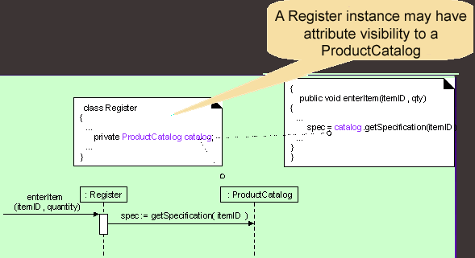
Attribute Visibility

Slide 11
Parameter Visibility
Parameter visibility from A to B exists when B is passed as a parameter to a method of A.
  Relatively temporary visibility because it persists only within the scope of the method
  The 2nd most common form of visibility in the OO systems

Slide 12
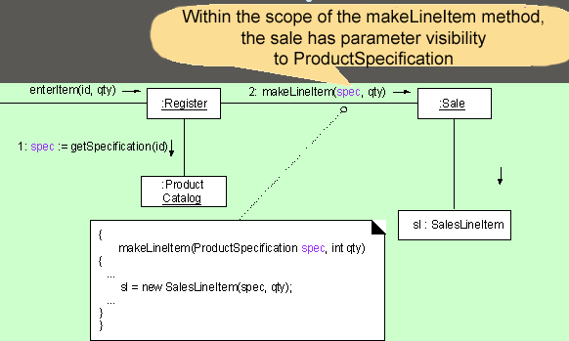
Parameter Visibility

Slide 13
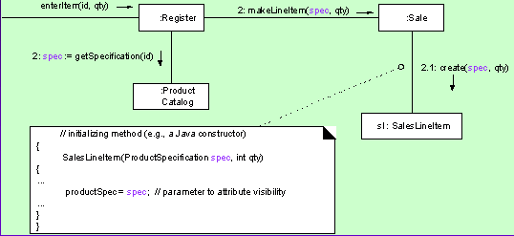
Parameter to attribute Visibility
It is common to transform parameter visibility into attribute visibility.

Slide 14
Local Visibility
Local visibility from A to B exists when B is declared as a local object within a method of A.
  Relatively temporary visibility since it persists only within the scope of the method.

Slide 15
Local Visibility
There are two common means by which
local visibility is achieved:
Create a new local instance and assign it to a local variable.
Assign the returning object from a method invocation to a local variable. A variation of this method does not explicitly declare a variable, but one implicitly exists as the result of a returning object from a method invocation
Ex: anObject.getAnotherObject.doSomething();

Slide 16
Global Visibility
Global visibility from A to B exists when B is global to A.
  Relatively permanent visibility since it persists as long as A and B exist.
  The least common form of visibility in OO Systems.

Slide 17
Global Visibility
Ways to achieve global visibility:
  Assign an instance to a global variable.
  Use the Singleton pattern

Slide 18
Singleton Pattern (Gang of Four)
Problem:
  Exactly one instance of a class is needed. Objects need a single point of access.
Solution:
  Define a class method that returns the singleton object, instantiating it if it does not exist.
Example:
  A print queue—many programs must access one queue

Slide 19
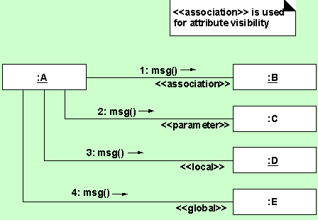
Illustrating Visibility in the UML

